Slide 1
Yelp Team Project
Team 15: Gabriel Ascencio Morales, Luke Watts, Taylor Wilson, Leonie Zhang

Slide 2










Summary Statistics
Based on the Yelp database, we created the following summary statistics for the purpose of having a high-level understanding of the company
Total no.
of Users
13,261
Average
Review Count
per User
23.3
The Yelp database shows a sample of users that has been actively posting reviews since at least 2005. The average number of reviews posted per year is larger for users that have been on the website longer: for example, the average number of reviews posted per user was 161 in 2005–which is 43x larger than the average for 2017 (3.7)
Total no.
of Cities
434
Average
Review Count
per Business
109.6
Total no.
of Businesses
28,450
Most Reviewed Category
French, Steakhouses, Restaurants, Breakfast & Brunch
Most Reviewed Business
Mon Ami Gabi
7,361
Most
Popular
Category
Mexican Restaurants
Average
Stars
per Business
3.7
City with the
most reviews
Las Vegas
1,217,597
Note: It is important to consider that the review counts per user (derived from the “user” table) are not the same as the review counts per business (derived from the “business” table). Furthermore, it should be noted that the number of distinct review_id entries in the “review” table is only 48,862–which differs significantly from the total review counts of 3,118,624 in the “business” table and 309,527 in the “user” table. For many of these summary statistics–such as average review count per user and average review count per business–, the business counts used as reference were the ones corresponding to their respective tables.

Slide 3
Business Question
QUESTION: Within the most reviewed city, how do ratings vary according to the time of day check-ins were made?
Methodology
Our methodology focused on determining the most reviewed city and the number of check-ins per business for a number of time-frames. We then joined the check-ins with their corresponding business IDs, determined the number of stars for each business, and defined the average star ratings for the most representative time-frames of each business
Determine the most reviewed city
Define time-frames of analysis
Obtain the number of check-ins per time-frame in the most reviewed city
Join the check-ins per time-frame to corresponding businesses
Obtain the average star rating for the most representative time-frames of each business
Notes:
--City with the most reviews
SELECT city, sum(review_count) as reviews
FROM business
GROUP BY City
ORDER BY Reviews DESC
limit 1;

Slide 4
Business Question
QUESTION: Within the most reviewed city, how do ratings vary according to the time of day check-ins were made?
We found that the most reviewed city was Las Vegas according to the query results below
City | Reviews
Las Vegas | 1,217,597
Phoenix | 353,861
Toronto | 210,546
Scottsdale | 195,858
Charlotte | 126,236
Notes:
--City with the most reviews
SELECT city, sum(review_count) as reviews
FROM business
GROUP BY City
ORDER BY Reviews DESC
limit 1;

Slide 5
Business Question
QUESTION: Within the most reviewed city, how do ratings vary according to the time of day check-ins were made?
Time-frames of analysis: “Day”: 7:00 to 18:00; “Night”: 19:00 to 6:00
The number of check-ins per time-frame in Las Vegas was calculated by adding all of the columns denoting a check-in time and assigning them to one of the aforementioned spans of time
Total check-ins in Las Vegas
Day | Night
658,592 | 1,965,456
Most check-ins are done at night. Venues that tend to check-in customers at night may include hotels, airports, and clubs

Slide 6
Business Question
QUESTION: Within the most reviewed city, how do ratings vary according to the time of day check-ins were made?
The number of check-ins for each time-frame were joined with their corresponding business IDs. We then used the case statement to determine the most predominant time-frame for each business and obtained the average for these time-frames across the Las Vegas data
Average rating per relevant time-frame
Day | 3.7
Night | 3.7
Equally-relevant | 3.9
Our results show that there are no significant differences in rating according to the most representative time-frame of check-ins. Ratings appear to be slightly higher for businesses in Las Vegas that have an equal number of check-ins during day and night

Slide 7
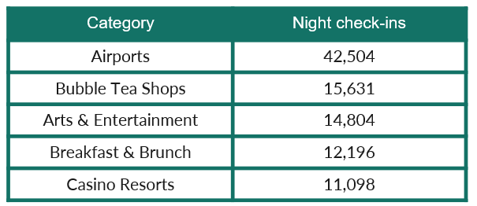
Business Question
QUESTION: Within the most reviewed city, how do ratings vary according to the time of day check-ins were made?
Conclusions
In Las Vegas, it seems that there are no significant differences in the star rating of a business depending on whether customer check-ins occur during the day or night
Most check-ins in Las Vegas are done during the night. Similarly, we found that night businesses also have the largest review count in the city
The night businesses with the most check-ins during the night in Las Vegas are the following:

